Slide 1


Slide 2
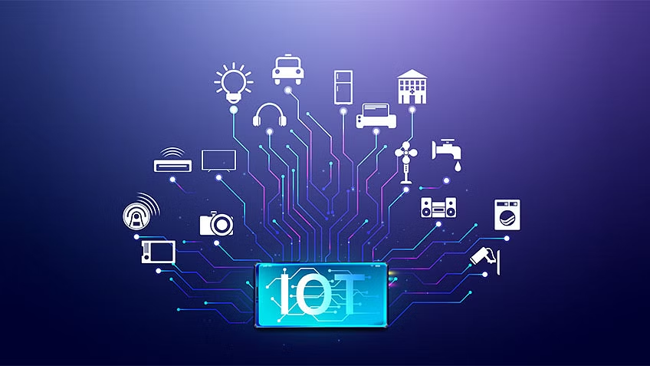
INTERNET of THINGS (IoT)

Slide 3
What is IoT
as well as between the devices themselves
refers to the collective network of connected devices and the technology that facilitates communication between devices and the cloud

Slide 4
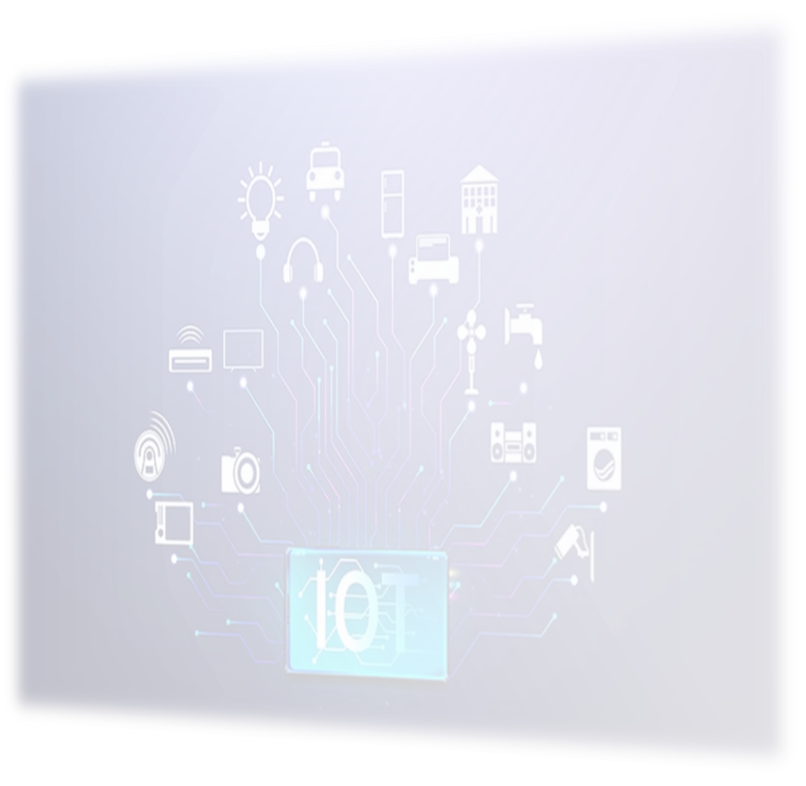
How Does it works?
Smart
devices
Devices that has been given computing capabilities
It collects data from its environment and communicates data over the internet to and from its IoT application.
IoT Applications
a collection of services and software that integrates data received from various IoT devices
It uses machine learning or artificial intelligence technology to analyze this data and make informed decisions
A graphical user Interface
IoT device can be managed through a graphical user interface
Common examples include a mobile application or website that can be used to register and control smart devices
decisions are communicated back to the IoT device and the IoT device then responds intelligently to inputs

Slide 5
What is LLN?
a class of network in which both the routers and their interconnect are constrained
LLN routers typically operate with constraints on processing power, memory, and energy (battery power)

Slide 6
Between devices inside the LLN
From a central control point to a subset of devices inside the LLN
From devices inside the LLN towards a central control point.

Slide 7
LLN and IoT
IoT is a more general concept that encompasses a wide range of devices and applications
LLN is a specific type of network that is optimized for low-power devices and lossy communication channels
IoT and LLN are both used for communication and networking purposes

Slide 8
Internal Attacks in IoT
Devices
Communication Channels
Application and Software
primary means by which attacks are initiated
vulnerabilities can come from memory, firmware, physical interface, web interface, and network services
Attackers can also take advantage of unsecure default settings, outdated components, and unsecure update mechanisms, among others.
Attacks can originate from the channels that connect IoT components with one another.
Protocols used in IoT systems can have security issues that can affect the entire systems.
Vulnerabilities in web applications and related software for IoT devices can lead to compromised systems.
Web applications can, for example, be exploited to steal user credentials or push malicious firmware updates.

Slide 9
How to mitigate with attacks?
All data being gathered and information being stored should be accounted
Each device being connected to the network should be configured with security in mind
The organization’s security strategy should be built on the assumption of compromise
Each device should be physically secured

Slide 10
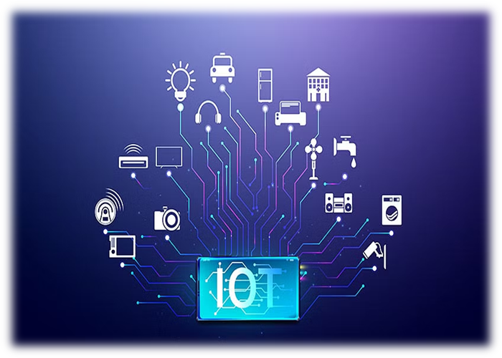
THANK YOU!

